Slide 1
Smart Plant Pot Device
By Oliver Richardson

Slide 2
What The Idea Was
A ‘Smart’ plant pot that can tell the user whether the location it is in has enough sunlight and when it needs to be watered.
The device collects a selection of data such as:
  The current temperature
  The current humidity
  The current light level
It then sends notifications to the user's phone to alert them to any issues with the plant's conditions.

Slide 3

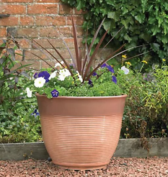
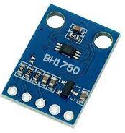
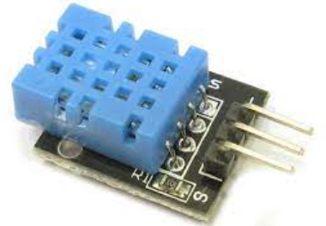
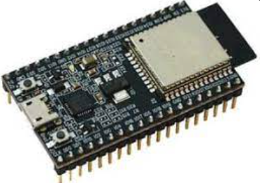
What The Idea Was
Alerts
Thermistor
Sunlight Sensor (BH1750)
Resistive Humidity Sensor
User Smartphone
Main Board (ESP32 Feather)

Slide 4
Power Management
The device will put itself into sleep mode which will end when either:
  The device is watered, at which point it will send a message to the user's phone before going back to sleep.
  It has slept for an hour.
This will reduce the power consumption of the device heavily as instead of always being on it will just turn on a few times for a short duration across the day.
The device also only turns on the Wi-Fi when it is needed to reduce the amount of time it is turned on and save more power.

Slide 5
Issues That Occurred
Original Sensors Didn’t work and had to be swapped.
Resistive Humidity sensor had far more resistance than initially thought.
Wi-Fi Interfered with Analogue read.
Notes:
The original DHT22 didn’t work and had to be swapped for a thermistor and Resistive Humidity Sensor.
The resistive humidity sensor was originally assumed to have around 1k ohms but actually had 10m ohms.
The Wi-Fi library uses some pins when it runs and when it gets turned off it disables those pins so analogue read no longer worked on them, so I had to do the readings before the Wi-Fi was turned off.

Slide 6
Further Potential
If this device was to be developed further the following are some ideas that could improve the device to make it more desirable to users:
Could Set up an automated system with servo motors that waters the device when it receives the MQTT messages rather than requiring the user to water the plant.
Could integrate a weather API to avoid sending messages when it is going to rain and alert to user that the temperature is going to change in advance.
Could develop the device into a smart green house to all it to control the environment of the plant itself automatically.

Slide 7
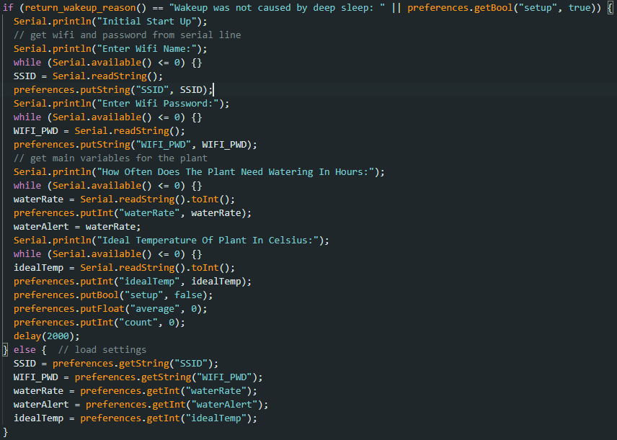
Device Set Up
Notes:
On initial set up the device asks the user for a set of information
On each subsequent boot of the device after deep sleep the device loads this information from flash memory
As the device only does an average of 3 writes per hours and 7 reads per cycle this gives a life time for the flash memory of 1 year
100k(average endurance) / 10 (or cycle of on average 1 hour) / 24 (cycles per day) / 365 (per year)

Slide 8
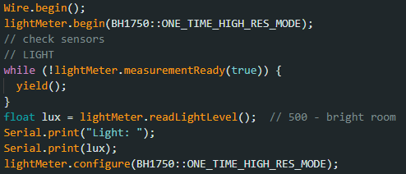
Light Meter
Notes:
Take a reading of the light in the area with the BH1750 library

Slide 9
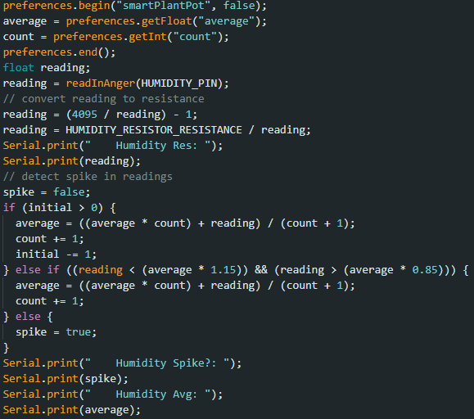

Humidity Sensor
Notes:
Take reading of the humidity in the area
Create an average of the humidity over 10 readings
If +/- 15% then mark reading as a spike which indicates the plant has been watered

Slide 10

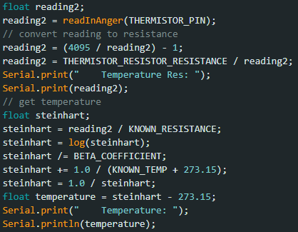
Thermistor
Notes:
Take a reading of the thermistor and convert it into resistance then use the Steinhart equation to convert it to temperature

Slide 11
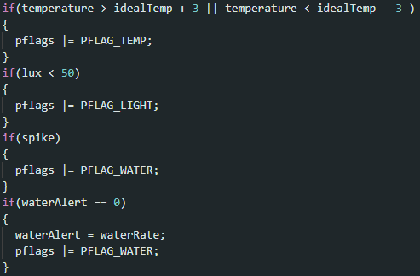
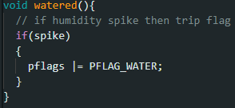

Flags
Notes:
The device uses flags to monitor when conditions are met for the MQTT messages to be sent

Slide 12
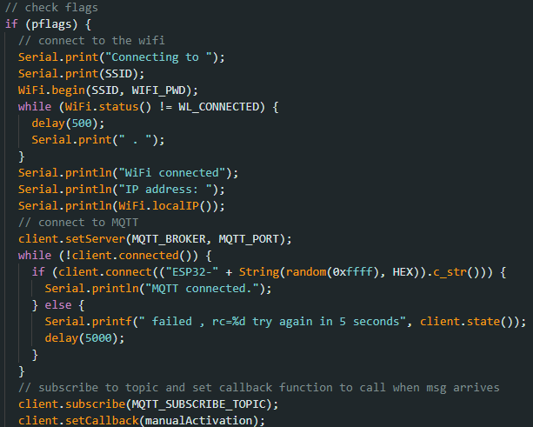
MQTT Set Up
Notes:
Connects to wifi and the MQTT server when it needs to send messages
(wifi connection happens after readings are taken as wifi disables some pins when it gets turned off which interferes with readings)

Slide 13
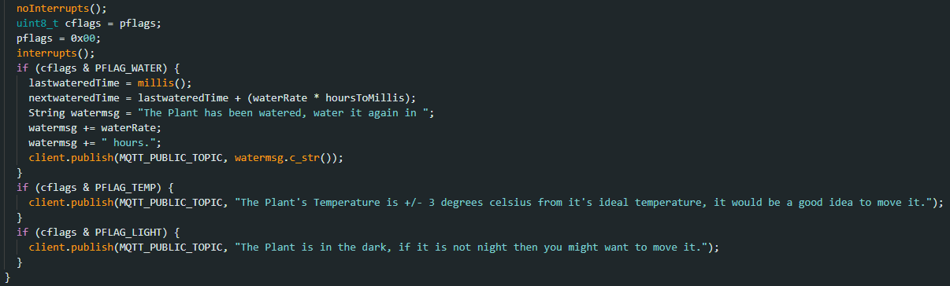
MQTT Messages
Notes:
Publishes MQTT messages when flags have been tripped

Slide 14
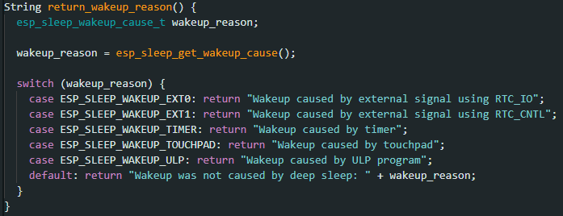

Deep Sleep
Notes:
Goes to deep sleep and wakes up when humidity sensor reading rises or an hours passes

